Slide 1
Total Official Support for Sustainable Development
CEPAL-OECD meeting
28 June, Santiago

Slide 2
COMPENDIUM STRUCTURE
Part I
Overview: origins, purpose, components, structure and implementation
Part II
Conceptual underpinnings, core components and statistical features
framing: 2030 Agenda and the AAAA
core architecture: provider and recipient perspectives
TOSSD-eligible activities, countries and instruments
measurement issues and features

Slide 3
WORKING DEFINITION
Total Official Support for Sustainable Development
includes all officially supported resource flows to promote sustainable development at developing country, regional and global levels with the majority of benefits destined for developing countries, including those resources that support development enablers or address global challenges.

Slide 4
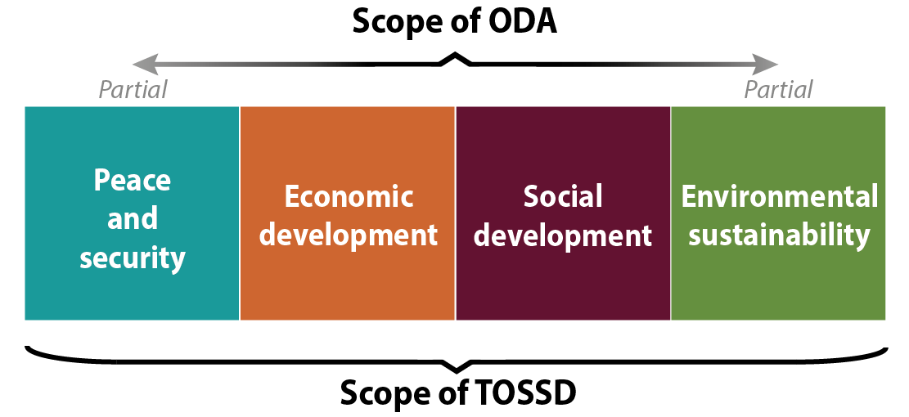
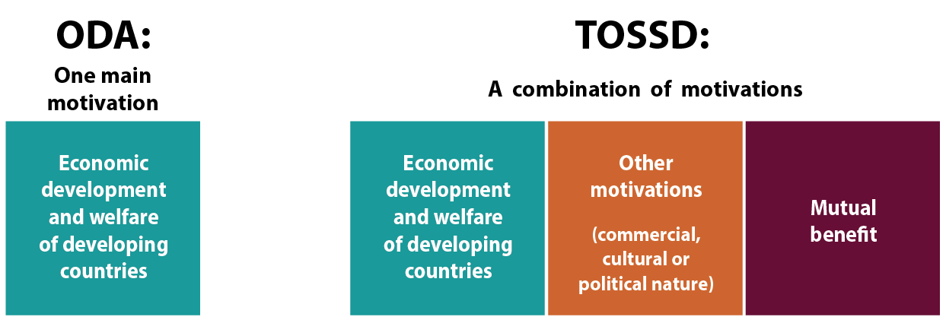
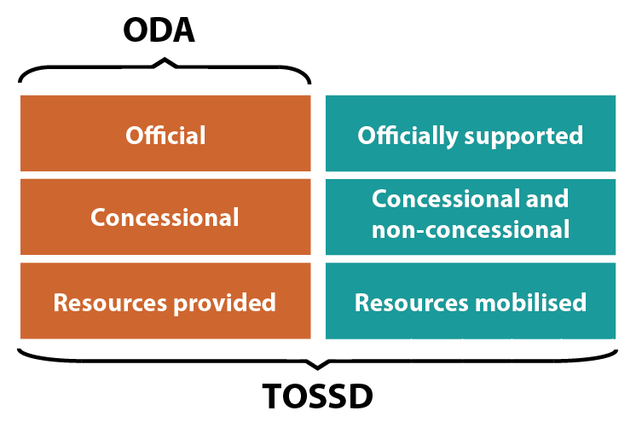
PURPOSE, SCOPE AND MOTIVATION OF TOSSD SUPPORT
Larger purpose reflecting modern development co-operation
Broader motivations
Framework for monitoring the
MoI of the 2030 Agenda

Slide 5
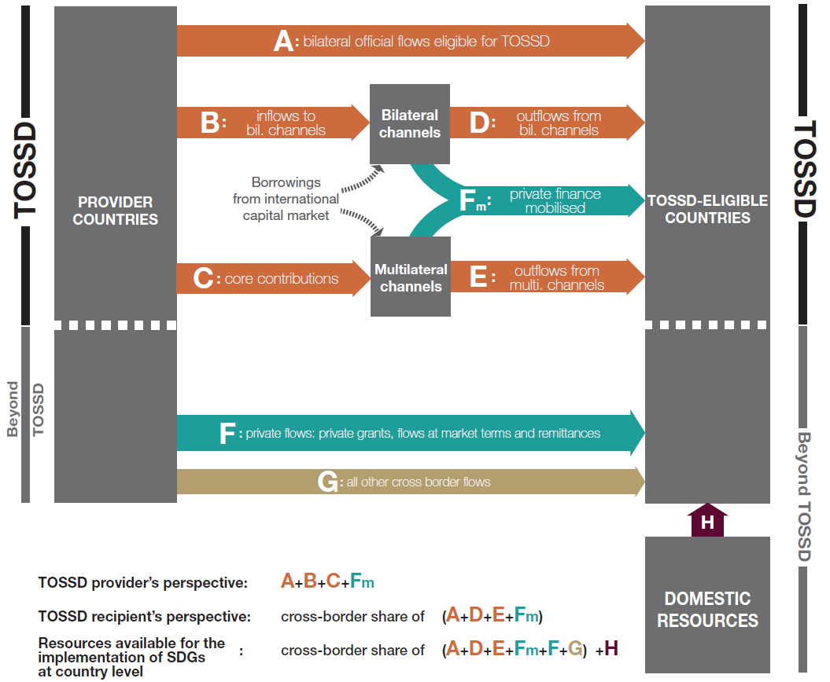
CORE ARCHITECTURE OF THE FRAMEWORK: the provider and recipient perspectives

Slide 6
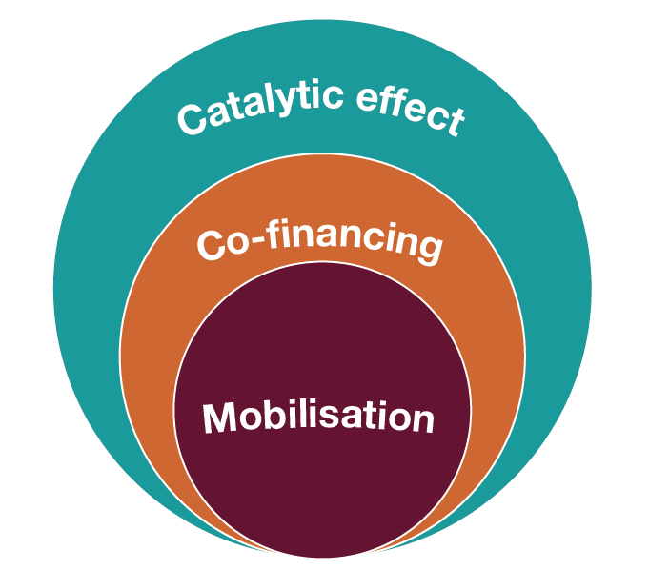
MEASURING BILLIONS TO TRILLIONS
For TOSSD, define measurement of private resources mobilised (direct mobilisation)
In future, TOSSD could incorporate estimates for indirect mobilisation (catalytic effect)
Avoid double-counting and harmonise methods for attribution (groundwork on tracking climate finance OECD-CPI Report)

Slide 7
THE COMPENDIUM INVITES DISCUSSION ON:
Political: core principles, relation to ODA, integration of the results agenda and future governance arrangements
Policy and technical:
List of TOSSD-eligible countries and providers
Boundaries of projects that support development enablers and address global challenges
Taxonomy of all financial instruments for inclusion in TOSSD and inclusion of mobilisation of private finance
Internationally agreed standards and principles that would apply (WTO, Equator Principles, Human Rights)

Slide 8
Public consultation on the Compendium
http://www.oecd.org/dac/financing-sustainable-development/tossd-public-consultation.htm

Slide 9
Thank you!

Slide 10
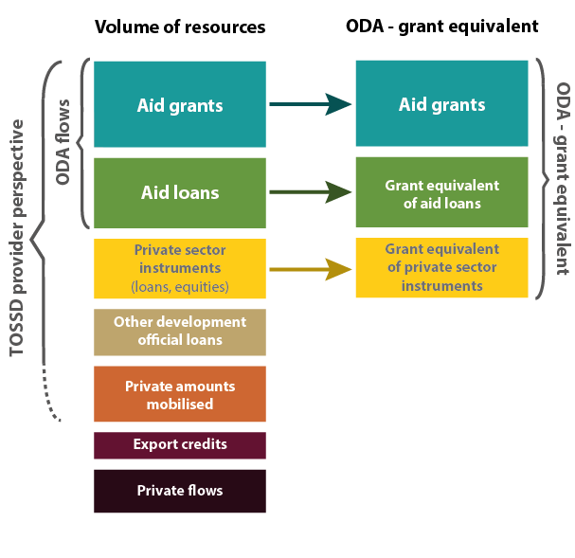
BACK-UP SLIDE
The difference between ODA and TOSSD:
volume of resources vs. grant equivalent

